Slide 1
Kiddie Tax Other Taxes
Pub 4012 – Tab H
Pub 4491 – Lesson 20

Slide 2
Lesson Topics
Kiddie Tax
Self-employment tax
Tax on Tip Income
10% tax on early distribution from retirement account
Tax on missed Required Minimum Distribution
First-time Homebuyer Credit repayment

Slide 3
Tax for Children with Unearned Income – “Kiddie Tax”
Pub 4012 Tab A
Taxpayer (refers to child) has more than $2,200 in unearned income
Taxpayer has a filing requirement
Find Pub 4012 Tab A Chart B For Children and Other Dependents
Taxpayer meets the test for kiddie tax – next slide
Taxpayer’s earned taxable income is taxed at ordinary rates while unearned income is taxed at trust rates
Preferential capital gains rates apply (modified)
Notes:
Encourage class to read notes at the top of Chart B and the bottom section on the kiddie tax

Slide 4
Kiddie Tax Filing Requirements – Must Meet ALL
Taxpayer (child) either:
Under age 18 December 31, 2018 -OR-
Age 18 with earned income not more than half their support* -OR-
Full-time student 19 to under 24 with earned income not more than half their support*
Taxpayer has at least one living parent
Taxpayer does not file a joint return
Not required that the earned income be used for his/her support – just that the student earns that amount or more
Notes:
Find worksheet for determining support in Pub 4012 Tab C

Slide 5
Kiddie Tax
It does not matter whether the child is a dependent
Being a dependent is not a criterion for the kiddie tax
It does not matter whether the parent has a filing requirement
In prior years would have negated the kiddie tax

Slide 6
Dependent Taxpayer (Child) Required to File…
Pub 4012 Tab A
Must file a return if any of the following apply
1. Unearned income was over $1,100
2. Earned income was over $12,200
3. Gross income was more than the larger of —
a. $1,100, or
b. Earned income (up to $11,850) plus $350
Taxable Scholarships are considered earned income to determine filing requirement and standard deduction, but unearned income for all other aspects

Slide 7
Kiddie Tax – Steps to Take
Pub 4012 Tab H
Determine if taxpayer is potentially subject to kiddie tax
Do they meet the tests (age, insufficient earned income, living parent, not MFJ)
Find criteria in NTTC Modified Pub 4012 Tab H
If so, add Form 8615 to compute the kiddie tax
TaxSlayer computes the kiddie tax correctly
Notes:
Will need to discuss in the interview the cost of support of the child – find worksheet in P4012 Tab C – worksheet for determining support

Slide 8
Kiddie Tax Filing Requirements
Taxable scholarship income alone may not generate filing requirement
If no filing requirement, no Form 8615 required
Example: $10,000 taxable scholarship but no other income
Below $12,200 earned income threshold so no filing requirement
Notes:
Taxable scholarships are considered unearned income for most purposes but is considered earned income when determining a filing requirement.

Slide 9
Kiddie Tax Quiz 1
Eddie is 20 years old and a full time student who earned $9,000 working part time
He also has a taxable Pell grant of $2,500
Is Eddie subject to the kiddie tax?
No – Eddie does not have a filing requirement
The Pell grant is earned income for the gross income filing threshold

Slide 10
Kiddie Tax Quiz 2
Same as Quiz 1 except Eddie’s taxable Pell grant is $3,500
Is Eddie subject to the kiddie tax?
Yes – Eddie’s earned taxable income is more than $12,200 so he has a filing requirement
The taxable Pell grant is unearned income for Kiddie tax and exceeds the $2,200 Kiddie tax threshold

Slide 11
Form 8615 in TaxSlayer
Pub 4012 Tab H
Verify taxpayer meets all requirements to file form (age, insufficient earned income, living parent, etc.)
Only then manually add and fill in Form 8615
TaxSlayer does not automatically add form
Caution: TaxSlayer will compute the Kiddie tax when Form 8615 is added regardless of age (no verification)
Complete state form for states with in-scope Kiddie tax
Notes:
If, based on the interview the preparer determines that the taxpayer meets the rules that make him or her potentially subject to the kiddie tax (slide 5), complete the Form 8615 information. In the event that the taxpayer’s income isn’t subject to the kiddie tax then none will be calculated.
TaxSlayer does not automatically invoke the kiddie tax, it is activated only if the preparer explicitly adds it
Must enter the parents’ information. If that isn’t done then the kiddie tax isn’t calculated.
TaxSlayer doesn’t check against the taxpayer’s age and could calculate a kiddie tax even if the taxpayer is over 23. Counselors make the sole determination whether the taxpayer should be subject to the kiddie tax. And the taxpayer could be subject to the kiddie tax even if they can’t be claimed as a dependent.

Slide 12
Kiddie Tax – TaxSlayer Entry
Unearned
Prepare return and enter taxpayer’s (child’s) income as usual
TaxSlayer will identify as earned and unearned correctly
Enter Form 8615 in form selection box -or- Federal Section > Other Taxes > 8615
Enter Parent’s name and SSN
TaxSlayer calculates Kiddie Tax
Notes:
Enter earned and unearned income into TaxSlayer, select 8615 and enter Parent’s/SSN ... TaxSlayer does the rest

Slide 13
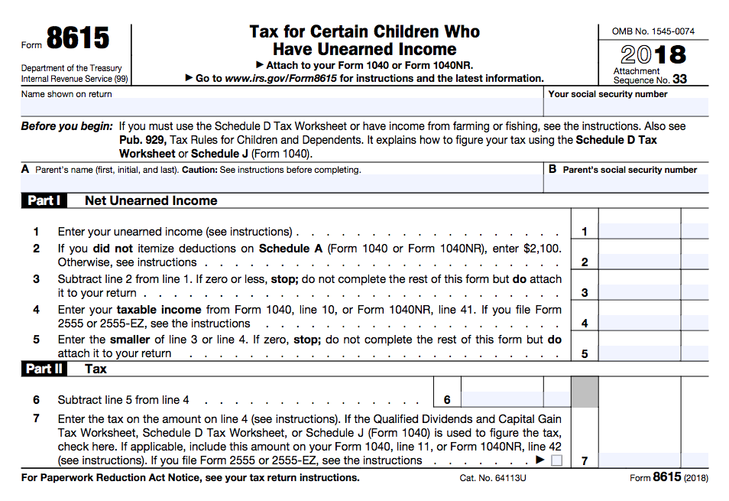
Kiddie Tax – Parent Information
Enter parent’s name and SSN:
Parents married to each other filing MFJ, enter name listed first on tax return
Parents married to each other filing MFS, enter name of parent with higher taxable income
Unmarried, treated as unmarried (HoH), or separated parents, enter name of custodial parent
Unmarried parents living together, enter name of parent with higher taxable income
Notes:
Not sure why form asks for parent’s information. No longer relevant (so long as one is still alive)

Slide 14
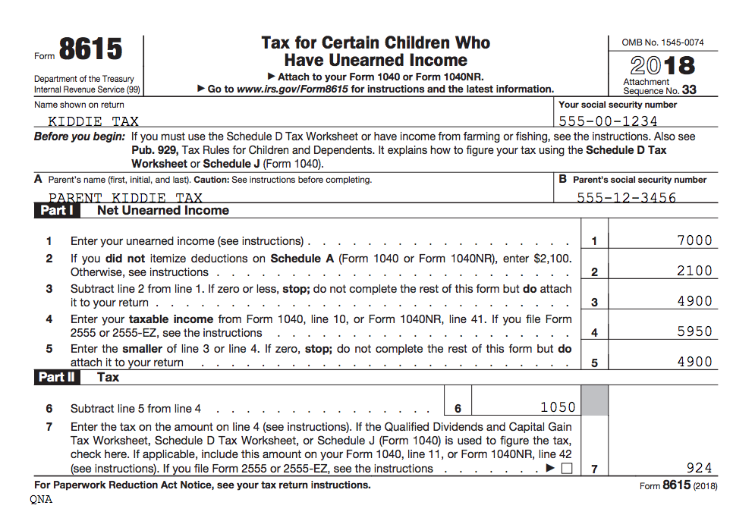
Kiddie Tax Example – Only Unearned Income
Dependent child has $7,000 interest income – no other income
Total tax including Form 8615 = $924
Total tax without Form 8615 = $598
Notes:
TaxSlayer prints the tax calculation worksheet. These numbers based on 2018 software.

Slide 15
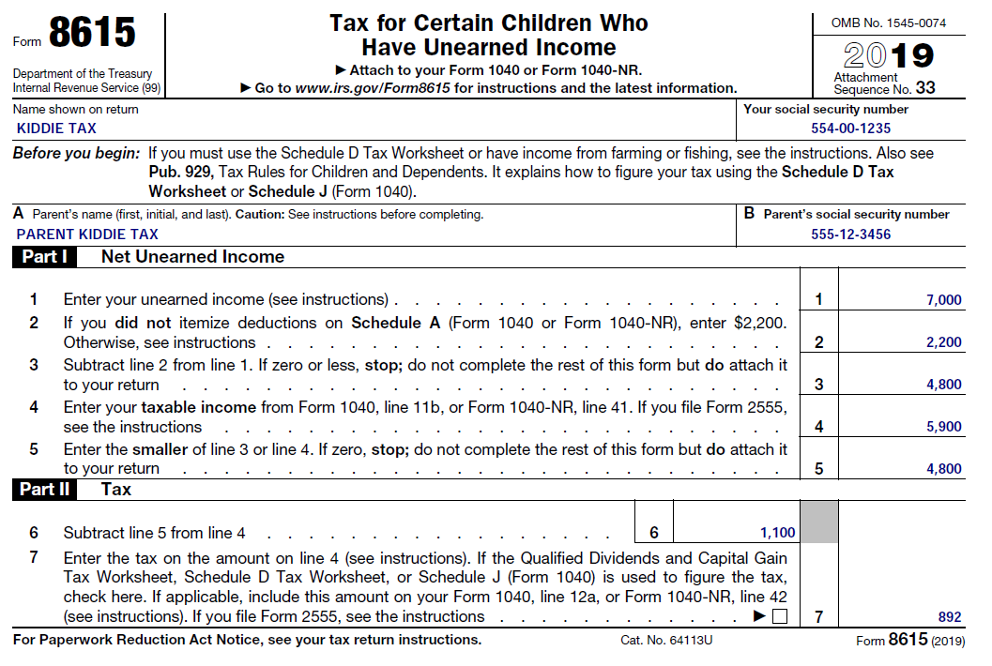
Kiddie Tax Example – Earned and Unearned Income
Same dependent child $7,000 interest income plus $5,000 W-2 income
Total tax including Form 8615 = $892
Total tax without Form 8615 = $593

Slide 16
Other Taxes in Scope
Self-employment tax (Schedule SE)
Social security and Medicare taxes on tip income
Additional taxes on IRAs and other qualified retirement plans
Repayment of first-time homebuyer credit
These taxes can be reduced by payments and refundable credits only

Slide 17
Self-employment Tax
Self-employment tax is in addition to income tax
Composed of two elements
Social security
Medicare
Self-employed person pays at 15.3%
TaxSlayer calculates Self-employment tax when data entered on Schedule C
TaxSlayer enters ½ as Self-Employment tax deduction

Slide 18
Self-employment Tax
Applies if net income from self-employment $400 or more
Does not apply to notary public
Does not apply to statutory employee (already withheld on W-2)
Special rules for ministers or church workers – out of scope
Notes:
Because ½ of the SE tax is reduces self-employment income for purposes of the SE tax, Sch C profit of less than $433 will not attract any SE tax

Slide 19
Self-employment Tax
NTTC-modified Pub 4012 Tab H
Notary public
Not subject to self-employment tax by law
NTTC Modified Pub 4012 Tab H Other Taxes and Payments
Enter the notary’s Schedule C profit on Schedule SE in TaxSlayer
Earnings not eligible for EIC

Slide 20
Social Security and Medicare Tax on Tip Income
Social Security and Medicare taxes withheld on W-2 box 7 tip income
Social Security and Medicare taxes not withheld on W-2 Box 8 Allocated tip income
TaxSlayer automatically calculates additional Social Security and Medicare taxes on Form 4137

Slide 21
Allocated Tip Income
Pub 4012 Tab D
Taxpayers with tip log or other records
Enter correct tip amount on Form 4137 (in place of reported allocated tip amount)
Pub 4012 Tab D
Tip logs available free from IRS

Slide 22
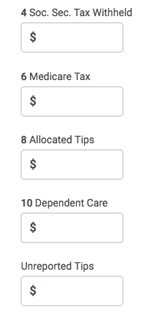
Tips Less than $20 in a Month
Not required to report to employer
Presumed included in allocated tips for income
tax purposes
Enter on W-2 if not using allocated tip method
Not subject to Social Security/Medicare tax
Use Form 4137 Line 5 to remove from tax calculation

Slide 23
Tip Income – Self-Employed
If self-employed, enter tips on Schedule C as cash gross receipts
No other entry required

Slide 24
Tax on Early Distribution
Most retirement plan distributions (subject to tax) prior to age 59½ considered early distributions
Subject to 10% additional tax unless an exception applies
25% for SIMPLE IRAs
Applies to IRA and employer plan distributions

Slide 25
Tax on Early Distribution
Pub 4012 Tab H
Find Other Taxes and Payments (continued) in Pub 4012 Tab H – Form 5329 TaxSlayer input
Some exception codes apply to IRAs
Some exception codes apply to employer plans [such as 401(k)]
Some exception codes apply to both

Slide 26
Common Exception Codes
Pub 4012 Tab H
05 The amount paid for medical expenses, minus 10% of AGI
Same amount as would show on Schedule A
No tracing of funds needed – simply have medical expenses
09 Used to buy or build first main home
Must be used within 120 days of distribution
12 More than one exception code or other reason
See footnote 2 to exceptions list in Pub 4012 Tab H
Use also for distributions incorrectly coded on Form 1099-R
Notes:
Highlight common codes seen in your area

Slide 27
Common Exception Codes
Pub 970 Chapter 9
08 Higher education expenses includes
Amount for self, spouse, foster child, adopted child or grandchild
Does not have to be a dependent
Tuition, fees, books, supplies and equipment required to enroll or attend
Special needs services expenses for special needs student
Notes:
See Pub 970 Chapter 9 for additional information

Slide 28
Common Exception Codes
08 Education (cont.)
Room and board if student is at least half-time
Can be at-home room and board
Based on allowance established by education institution
Reduced for nontaxable scholarships, grants or ESA distributions (but not Qualified Tuition Program distributions)
No tracing of funds is required – exception can be used if education expenses were paid
Expenses can be used for the exception and as an education benefit
Notes:
Expenses can be used for both exception from 10% penalty and as and education benefit because not using expenses to reduced TAX on distribution. Taxpayer only using expenses to get out of additional 10% penalty on the early distribution.
Room and board amount may be limited – refer to Pub 970, Ch 9.

Slide 29
Early Distribution Quiz
Joyce, age 50, has no medical insurance
She took a $10,000 distribution from her traditional IRA in June 2019 when she broke her arm
Her total unreimbursed medical expenses for the year were $8,000
Her AGI is $50,000
Q: What, if any, is the additional tax due on this distribution?

Slide 30
Early Distribution Quiz Answer: $700
Line | Form 5239 Part I Entry
1 | $10,000 [Early distribution included in income]
2 | Code 05 and $3,000 [Amount of early distribution not subject to additional tax] which is the $8,000 of medical expenses less 10% of her $50,000 AGI or $8,000 minus $5,000 = $3,000
3 | $7,000 [Amount subject to additional tax] which is $10,000 minus $3,000 from Line 2
4 | $700 [Additional tax = 10% of Line 3]

Slide 31
Missed RMD from Traditional IRA
Required Minimum Distribution (RMD) not taken after age 70½
IRA trustee normally calculates RMD but always taxpayer’s responsibility
RMD applies to total Traditional IRAs – not Roth IRAs
Inherited IRAs have different rules – Pub 590-B
Can request waiver of 50% additional tax – in scope for Tax-Aide
Notes:
Taxpayer can withdraw the RMD from any IRA so long as the total RMD is withdrawn
Waiver of 50% additional tax out of scope for VITA

Slide 32
Missed RMD
NTTC-modified Pub 4012 Tab H
Find Failure to take required minimum distribution in NTTC-modified Pub 4012 Tab H
Taxpayer must remedy distribution shortfall by taking additional distribution
Will result in more than one year’s distribution in year of remedy
Request waiver after distribution

Slide 33
Missed RMD
Possible explanations (examples):
Clerical or math error
Relied on Trustee who failed to make the RMD
Taxpayer impaired by health
Beneficiary not notified by trustee that RMD not taken
IRS accepts most reasonable explanations
Notes:
Math or clerical error

Slide 34
Missed RMD
Counselor not expected to verify that required distributions were taken
Ask taxpayers if they have an IRA
Ask taxpayers if they withdrew RMD
Remind taxpayers approaching age 70 of RMD requirement
Advise taxpayers to check with IRA Trustee

Slide 35
Additional Tax on Other Accounts Out of Scope
Remaining Form 5329 out of scope
Part II: 10% tax on education and ABLE accounts
Parts III – VIII: 6% tax on excess contributions to various qualified accounts not removed by due date of return

Slide 36
First-Time Homebuyers Credit Payback
Did taxpayer receive First-Time Homebuyers Credit (FTHC) in 2008?
Review 2018 return for repayment

Slide 37
First-Time Homebuyers Credit Payback
FTHC claimed in 2008
Repayment started 2010
Payments continue until full amount of credit repaid – usually $500 per year but can repay more
Form 5405 may not print – not needed for annual payback
May need to repay balance in some situations
Use IRS lookup tool to determine amount owed:
irs.gov > First-Time Homebuyer Credit Account Look-up
Notes:
The original amount was $7,500 repayable $500 per year
Repayments can continue through 2024

Slide 38
Home Ceases to be Main Home
Must repay balance of un-repaid credit with current tax return when home sold or no longer main home
Exceptions apply
Complete Part I of Form 5405
See Form 5405 instructions for additional repayment information

Slide 39
Home Ceases to be Main Home
Certain cessation events out of scope
Conversion to rental property
Condemnation
Foreclosure
If taxpayer and spouse claimed credit on joint return in 2008
Each files separate Form 5405 reporting their share

Slide 40
Exceptions to Full Repayment
Home sold to someone not related to taxpayer
repayment limited to gain on sale – Part III of Form 5405
Taxpayer or spouse dies before full repayment
Decedent’s share of credit does not have to be repaid
Home destroyed or sold through condemnation and new main home purchased within two years of event
continue with annual payments – out of scope

Slide 41
Quality Review
Review special situations for self-employment tax
Notary or statutory employee
Verify tax on tip income Form 4137 correct
Review exceptions for early distributions

Slide 42
Quality Review
Request a waiver if RMD missed
Confirm First-Time Homebuyers Credit repayment
Review return for kiddie tax consequences

Slide 43
Other Taxes
Questions?
Comments?
Notes:
43

